Slide 1
Predicting Financial Inclusion in East Africa
Comparing KNN, Decision Tree, ANN, SVM and LDA classifiers with 2-fold cross-validation
Objective: Given a person's demographic and socio-economic profile, can a machine predict whether they have a bank account?
David Gathage - 223405
Aicha Zindamoyen - 134141
Notes:
Binary classification task on survey data from Kenya, Rwanda, Tanzania and Uganda. Five classic algorithms are compared under an identical protocol: same preprocessing, same 2-fold stratified cross-validation.

Slide 2
Why financial inclusion?
A bank account lets people save safely, borrow, insure against risk and receive payments. Across sub-Saharan Africa, only about half of adults hold any account, and far fewer hold a formal bank account (Demirgüç-Kunt et al., 2022). Knowing who is excluded, and which characteristics predict exclusion, helps banks, mobile-money operators and policymakers target the right products and policy.
This project tests whether five standard machine-learning methods can learn that prediction from national survey data, and which method does it best.
23,524
4
survey respondents
countries: KE, RW, TZ, UG
14%
11
have a bank account
predictor variables
Notes:
Framing slide. The 14% base rate is the key number - it defines the 86% baseline any model must beat and drives the whole discussion of accuracy vs recall.

Slide 3
Related works
Related works
1. Demirguc-Kunt et al. (2022) - The Global Findex Database 2021, World Bank
Documents account ownership worldwide; in sub-Saharan Africa just over half of adults hold an account, with mobile money driving most recent gains.
2. Suri, T., & Jack, W. (2016) - The long-run poverty and gender impacts of mobile money
Access to M-Pesa mobile money lifted an estimated 2% of Kenyan households out of extreme poverty. A causal case for expanding financial access.
3. Dataset's origin: Zindi (2019) - 'Financial Inclusion in Africa' challenge.
Released the FinScope/FinAccess survey data used here (2016-2018) and framed bank-account prediction as a supervised learning task.
4. Comparing classic classifiers - Acharya & Shaileshbhai (2024)
Comparative studies of KNN, SVM, Decision Trees and neural networks on financial and credit data consistently find that the winner is dataset-dependent. That is the case for running a controlled comparison on this dataset.
Notes:
Two strands of prior work: (1) financial-inclusion research establishing the problem's importance and its measurement; (2) ML literature comparing these same five algorithm families, which finds no universal winner - hence this experiment.

Slide 4
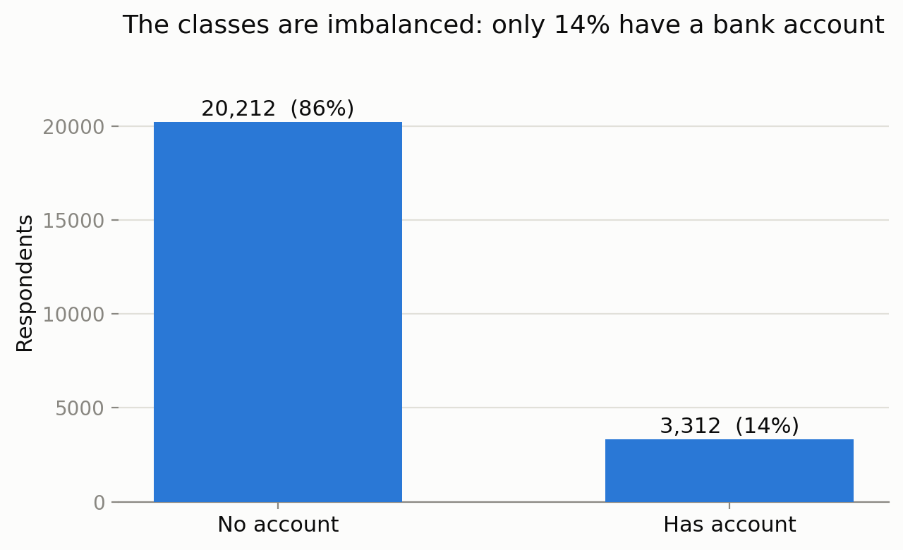
Training data construction
Get the dataset. FinScope / FinAccess national surveys 2016-2018 (via the Zindi challenge): 23,524 rows, 13 columns, 0 missing values.
Clean dataset. Drop the uniqueid row identifier; map the target bank_account to 1 (Yes) / 0 (No).
Encode the 9 categorical variables (country, location, cellphone access, gender, relationship, marital status, education, job type, survey year).
Scale by standardizing the 2 numeric variables (household size, age) to mean 0, s.d. 1 - essential for the distance-based KNN and SVM and for the ANN.
Validate - Stratified, shuffled 2-fold cross-validation: train on one half, test on the other, then swap. All preprocessing is fitted inside each fold to prevent data leakage.
86% of respondents have no account, so a model that always answers “No” is already 85.9% accurate. Real data is above the differential.
Notes:
Identical preparation for all four models, wrapped in a scikit-learn Pipeline so the scaler and encoder only ever see the training fold - avoiding data leakage. After one-hot encoding the models see about 50 input columns.

Slide 5





The ML methods used
KNN
Decision Tree
ANN (MLP)
SVM (RBF)
LDA
Asks the 15 most similar respondents and takes a distance-weighted vote.
Learns a flowchart of yes/no questions that best separate the classes.
Layers of neurons learn non-linear feature interactions by backpropagation.
Finds the widest-margin boundary; the kernel allows it to curve.
Finds the straight line that best separates the two classes.
k = 15, distance weighting
max depth 10, min 25 per leaf
hidden layers 64 + 32, ReLU, Adam, early stopping
C = 1.0, gamma = scale
solver = svd, no tuning needed
Same data, same preprocessing, same 2-fold stratified cross-validation for all five models - so any accuracy difference comes down to the algorithm itself.
Notes:
One card per algorithm (five in total) with its key settings. Class weighting was deliberately not used on the tree and SVM because KNN and the ANN have no equivalent - keeping the comparison fair.

Slide 6
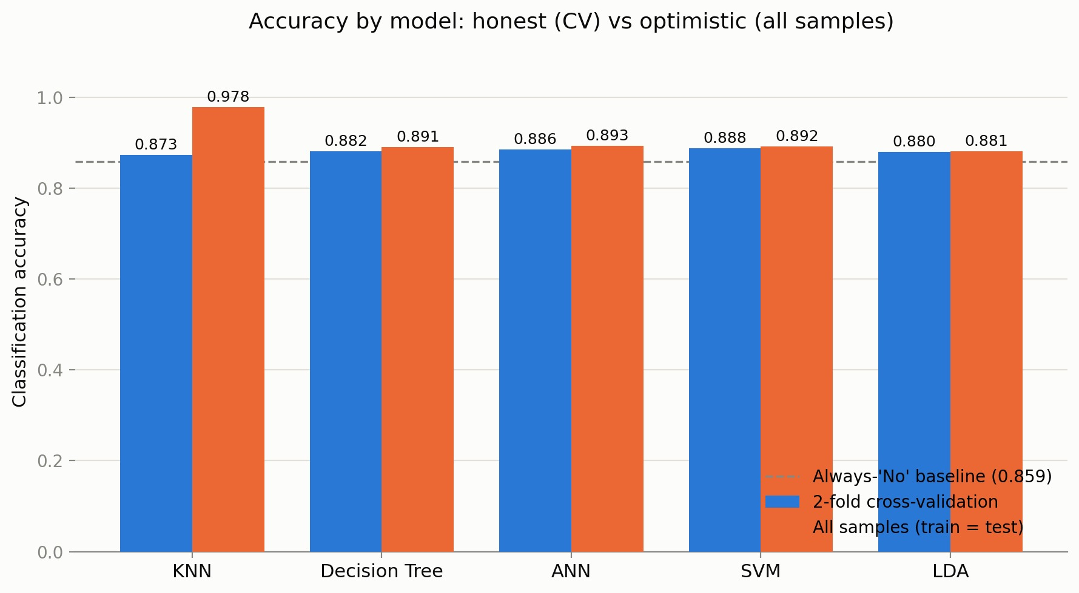
Classification accuracy - all samples
SVM is the most accurate - 88.8% under 2-fold CV, with ANN (88.6%) and Decision Tree (88.2%) close behind.
KNN shows a tendency to memorize. This method scores 97.8% when tested on its own training data, but only 87.3% on unseen folds - the largest overfit gap (10.5 points).
The benchmark is 85.9%. Always answering “No account” scores 85.9%; All 5 models beat the benchmark, but by at most 2.9 points.
Notes:
Blue bars are the honest scores (every sample predicted by a model that never trained on it); orange bars are train-equals-test. The gap between a model's two bars measures memorization. Full per-fold numbers on the next slide.

Slide 7



Interpretation of Results
Model | Fold 1 | Fold 2 | 2-fold CV | All samples | Overfit gap | CV time (s)
KNN | 0.8747 | 0.8719 | 0.8733 | 0.9781 | 0.1048 | 15.4
Decision Tree | 0.8807 | 0.8828 | 0.8818 | 0.8908 | 0.0090 | 0.2
ANN | 0.8850 | 0.8868 | 0.8859 | 0.8930 | 0.0071 | 3.4
SVM | 0.8871 | 0.8891 | 0.8881 | 0.8921 | 0.0040 | 12.7
LDA | 0.8796 | 0.8808 | 0.8802 | 0.8808 | 0.0006 | 0.3
1. Consistency across folds
2. Accuracy is insufficient as a metric
3. Performance difference
Fold 1 and Fold 2 accuracies differ by at most 2 points for every model - the 2-fold estimates are stable.
All five models cluster within 1.5 points of each other under CV; the confusion matrices (next slide) separate them further.
The tree cross-validates in 0.2 s, the ANN in around 3 s, KNN in ~15 s and the SVM in ~13 s
Notes:
SVM row highlighted as the best cross-validated accuracy (0.8881). Note KNN's 0.1048 overfit gap versus SVM's 0.0040.

Slide 8
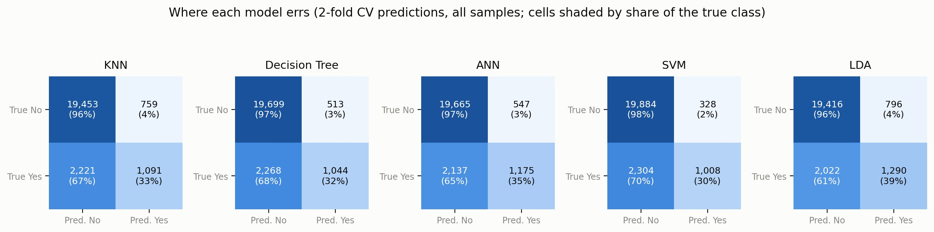
Discussion - where the models err
High accuracy is mostly the majority class
Different errors, similar accuracy
What would help next
Every model recognizes non-account-holders almost perfectly (96-98%) but finds only 30-39% of actual account holders.
SVM is the most conservative (fewest false “Yes”: 328) yet misses the most real account holders; LDA finds the most (1,290). Which is “best” depends on the cost of each error.
Class weighting or resampling (e.g. SMOTE), threshold tuning, and ensembles (Random Forest / gradient boosting) - all trade a little accuracy for much better minority-class recall.
Notes:
The confusion matrices come from the same 2-fold CV predictions as the accuracy chart - every one of the 23,524 samples appears exactly once. Percentages are shares of the true class (row-normalized).

Slide 9
Conclusions
SVM has the bet 2-fold CV accuracy (88.8%), with ANN (88.6%) statistically comes second at a fraction of the training cost.
On all-samples testing KNN looks like the best model (97.8%); under cross-validation it is the worst (87.3%).
Accuracy alone is a misleading metric. With 86% of respondents unbanked, the interesting signal is minority-class recall - where every model still has ample room to improve.
Recommendation: For this dataset: ANN or SVM with class rebalancing as the next step; the Decision Tree where interpretability for policymakers outweighs the last point of accuracy.
Notes:
Close by tying back to the problem: the models work, honest validation matters, and the next iteration should optimize for finding the excluded - not just overall accuracy.

Slide 10
References
Acharya, B. B., & Shaileshbhai, G. D. (2024). Comparative analysis of machine learning algorithms: KNN, SVM, Decision Tree and Logistic Regression for efficiency and performance. International Journal for Research in Applied Science & Engineering Technology, 12(11), 614–619. https://doi.org/10.22214/ijraset.2024.65138
Demirgüç-Kunt, A., Klapper, L., Singer, D., & Ansar, S. (2022). The Global Findex Database 2021: Financial inclusion, digital payments, and resilience in the age of COVID-19. World Bank. https://doi.org/10.1596/978-1-4648-1897-4
Suri, T., & Jack, W. (2016). The long-run poverty and gender impacts of mobile money. Science, 354(6317), 1288–1292. https://doi.org/10.1126/science.aah5309
Zindi. (2019). Financial Inclusion in Africa [Data set]. https://zindi.africa/competitions/financial-inclusion-in-africa
Notes:
Close by tying back to the problem: the models work, honest validation matters, and the next iteration should optimize for finding the excluded - not just overall accuracy.

